Slide 1
Synchronous solution
• Sleep & Wakeup
- Sleep is a call system that pauses the operation of the process of calling it and waits until it is processed by another protocol.
The Wakeup system call takes a single parameter: the process to be reactivated.
Semaphore
Message passing

Slide 2
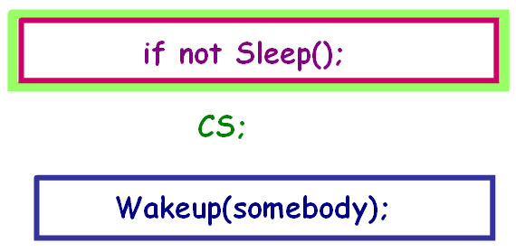
"Sleep & Wake up" solution
Give up CPU when not come in CS
When CS is empty, will be waken up to come in CS
Need support of OS
Because of changing status of process

Slide 3
"Sleep & Wake up" solution: Idea
OS support 2 primitive:
Sleep(): System call receives blocked status
WakeUp(P): P process receive ready status
Application
After checking condition, coming in CS or calling Sleep() depend on result of checking
Process that using CS before, will wake up processes blocked before

Slide 4
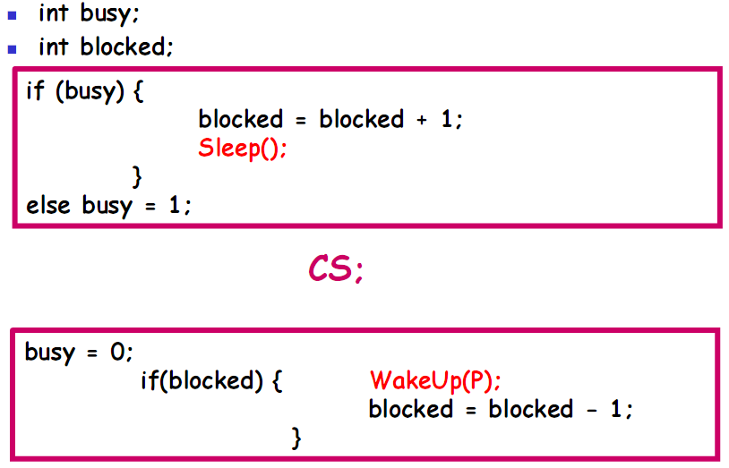
Apply Sleep() and Wakeup()

Slide 5
Problem with Sleep & WakeUp
Reason:
Checking the gauntlet domain and calling SLEEP or WAKEUP are separate actions, which can be interrupted halfway through processing, so sometimes the WAKEUP signal sent to an unlocked process will be lost.
Checking condition and giving up CPU can be broken
Lock variable is not protected

Slide 6
Semaphore
Suggested by Dijkstra, 1965
Properties: Semaphore s;
A positive integer value e(s) or called a semaphore s
A queue f(s) stores a list of processes that are locked (waiting) on the semaphore s
Manipulate with 2 primitives:
Down(s)
Up(s)
Down and Up primitives excuted cannot divide up

Slide 7
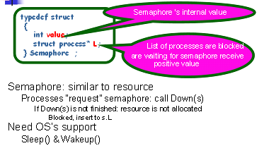
Install Semaphore (Sleep & Wakeup)

Slide 8
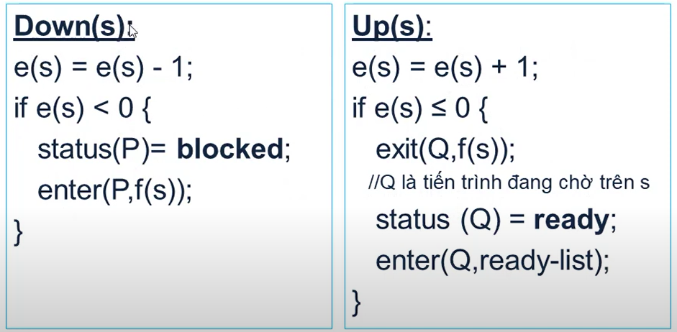
Install Semaphore (Sleep & Wakeup)

Slide 9
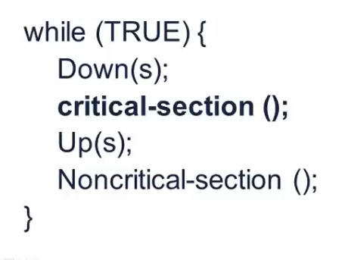
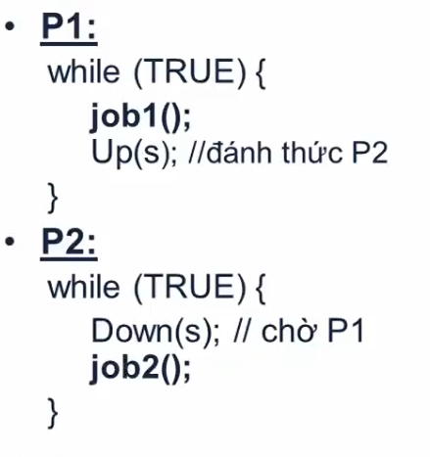
Using Semaphore
Exclusive access
Coordination organization

Slide 10
Monitor
Hoare (1974) & Brinch (1975)
Synchronous mechanism is provided by programming language
Support with functions, such as Semaphore
Easier for using and detecting than Semaphore
Ensure Mutual Exclusion automatically
Using condition variable to perform Synchronization

Slide 11
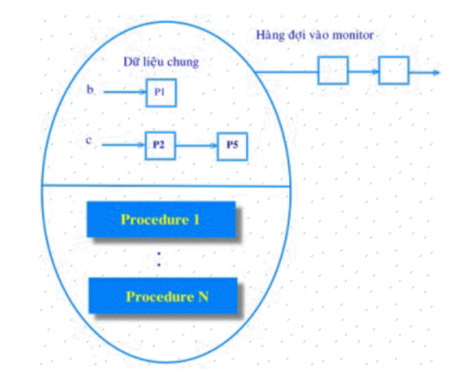
Monitor: structure

Slide 12
Monitor: structure
monitor monitor-name
{
shared variable declarations
procedure body P1 (…) {
. . .
}
procedure body P2 (…) {
. . .
}
procedure body Pn (…) {
. . .
}
{
initialization code
}
}

Slide 13
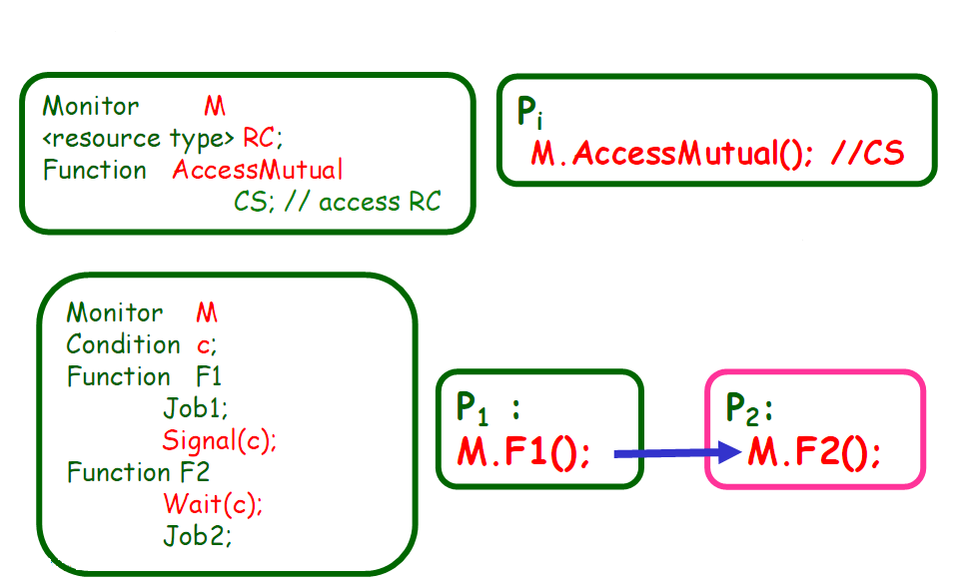
Using Monitor

Slide 14
Message Passing
Processes must name each other explicitly:
send (P, message) – send a message to process P
receive(Q, message) – receive a message from process Q
Properties of communication link
Links are established automatically
A link is associated with exactly one pair of communicating processes
Between each pair there exists exactly one link
The link may be unidirectional, but is usually bi-directional

Slide 15
Classical Problems of Synchronization
Bounded-Buffer Problem
(Producer-Consumer Problem)
Readers and Writers Problem
Dining-Philosophers Problem

